Slide 1
JD CENTRAL Open Platform MRD
Service name: MOLOG WMS
27 October 2021

Slide 2
Content
1
Company Introduction and Contact Information
2
API Requirement

Slide 3
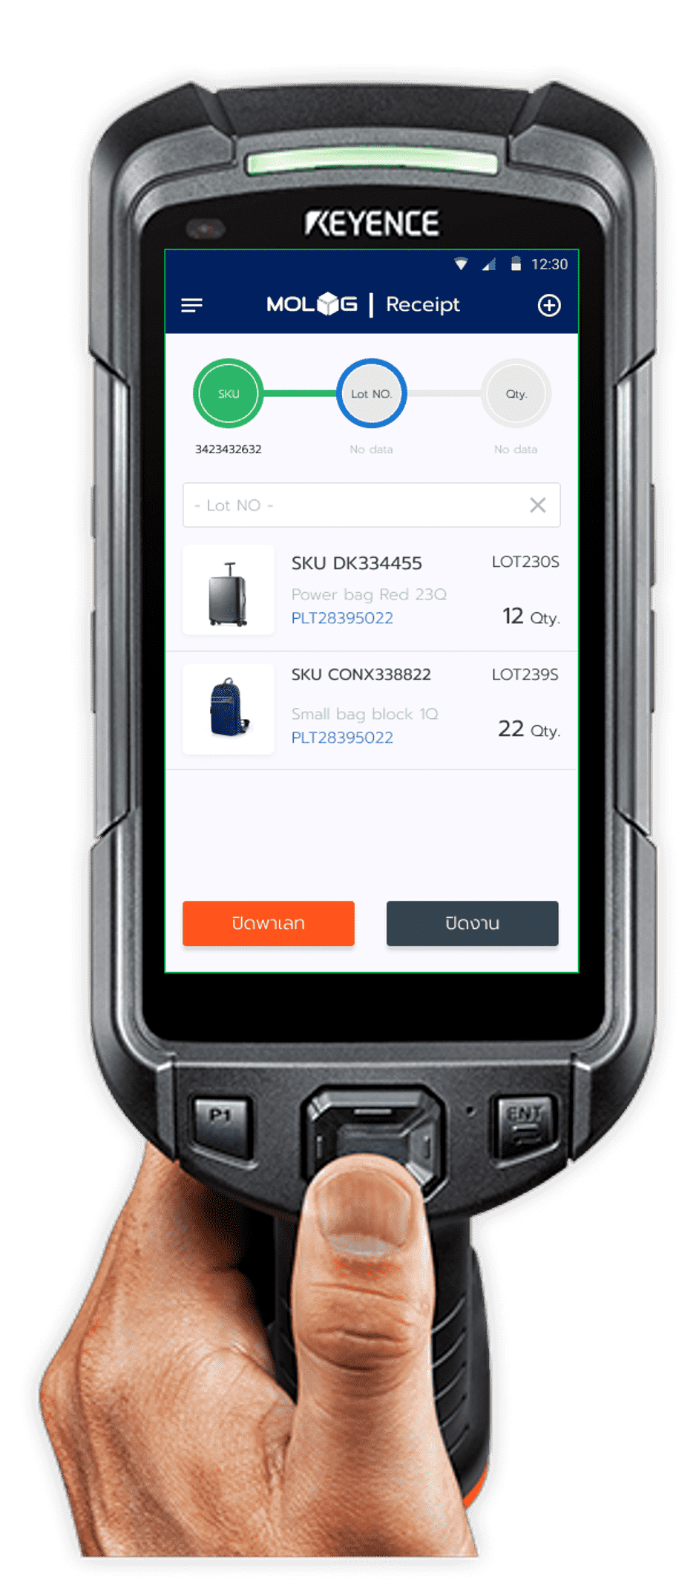
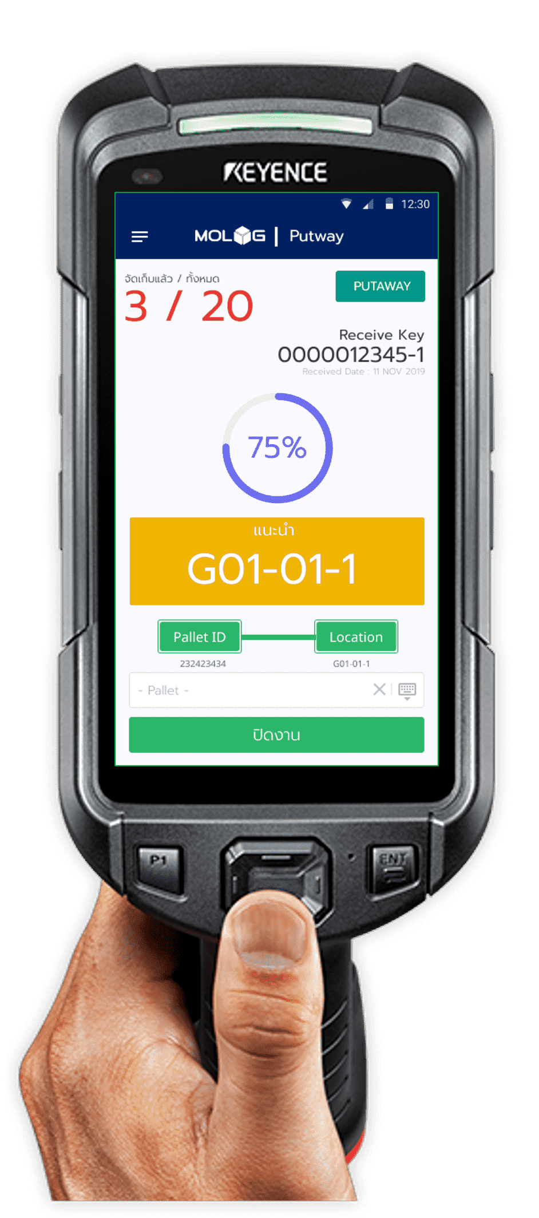
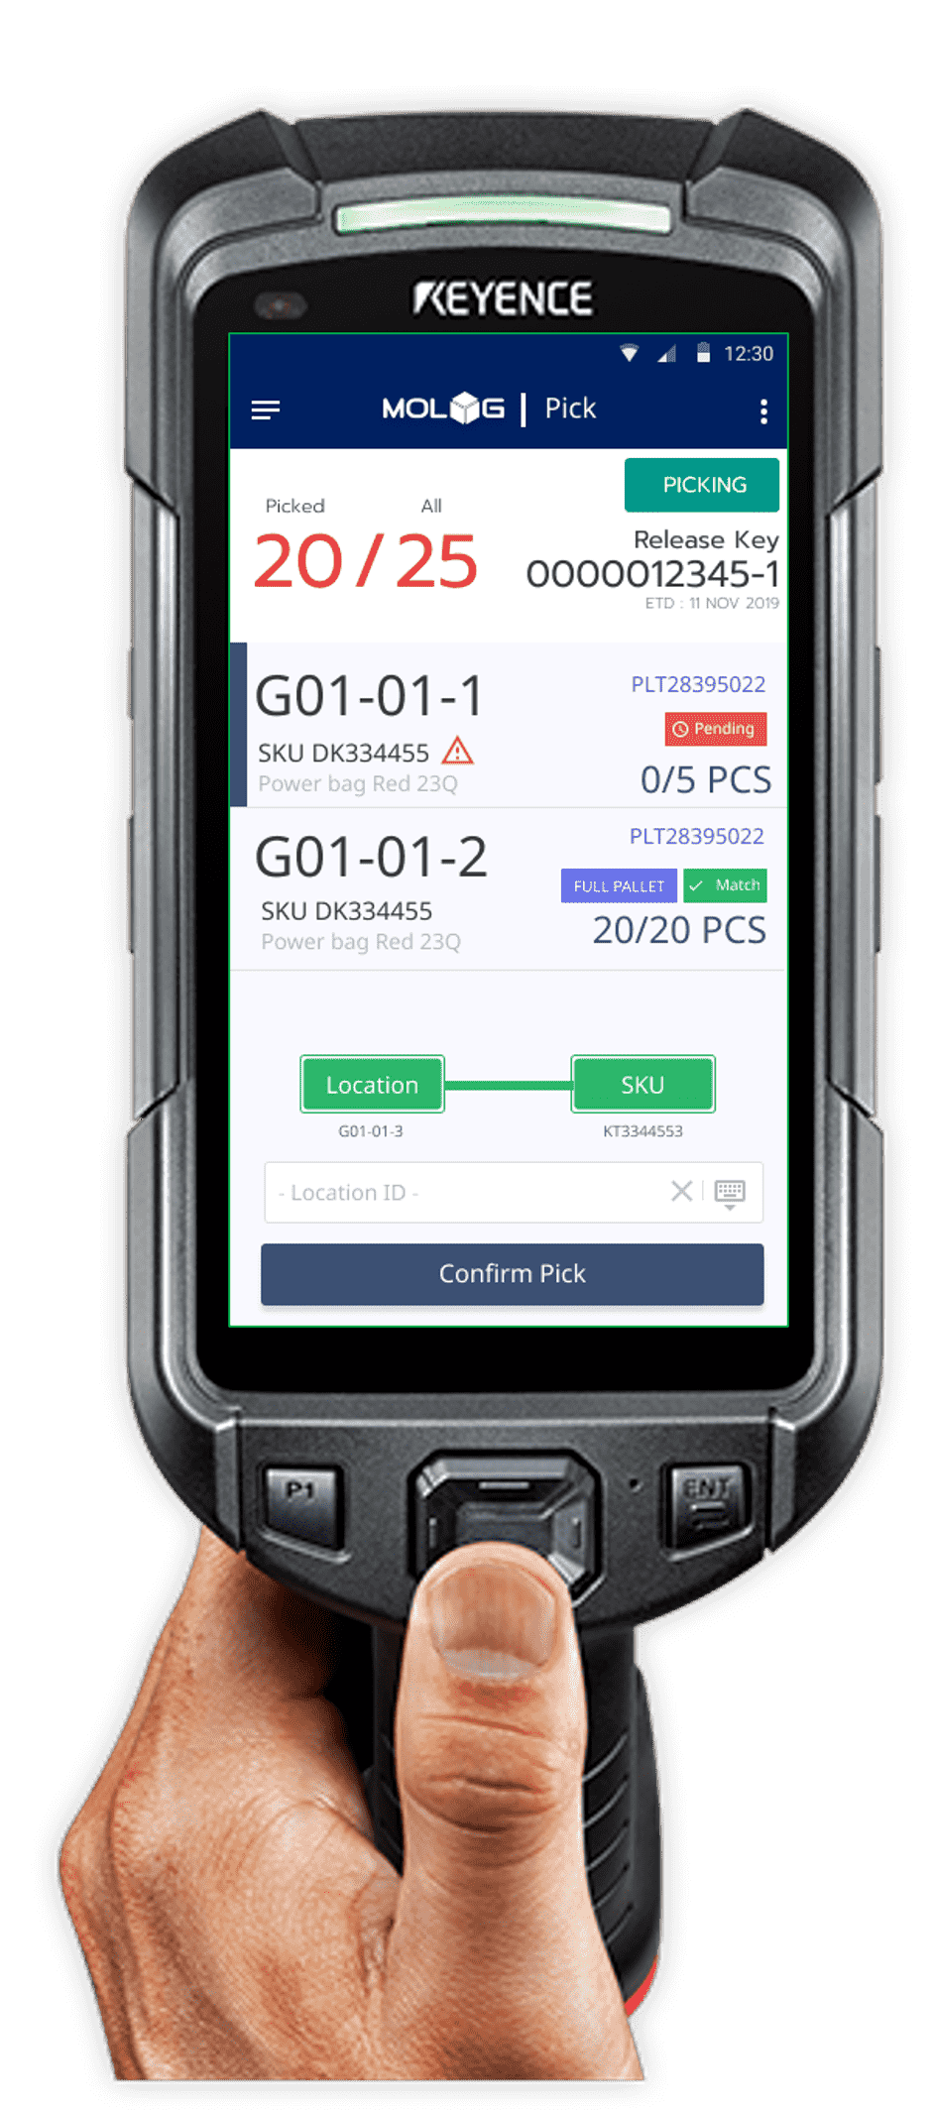
Company Introduction and Contact Information
We are MOLOG. We are WMS Platform (Warehouse Management System) that service our customer on SaaS and On Prem. Our system handheld Stock, Shipment Delivery and PO.
Our system deeply in warehouse business and Scanning System such as Scan In, Scan Pick, Scan Pack, etc.
Contact Us at https://www.customerwebhere.com
Me: [Customer Name], [Customer Email], [Customer Mobile Phone]

Slide 4
API Requirement
Please describe your API call scenario？
Get Sale order from Marketplace
MOLOG will allocate job by FIFO. [After this step we will send inventory update to you]
Operation Picker will scanning product on shelf.
Status turn to be PICKED. [After this step we will sent Update Shipment Packed to you and get AWB to our system]
Then operation go to packing job into carton and put AWB in carton. Then confirm job. [After this step we will send Ready To Ship to you]
For Get cancel, return, update product we will schedule by job corn.
Which API names or modules would you like to call?
Get Sale order
Get Cancel Sale Order
Get Edit Sale Order
Get Return Sale Order
Update Inventory
Update Shipment Packed
Update Shipment Ready To Ship
Get AWB
Post/Update Product

Slide 5

Thank You!

